Slide 1
CS2006 Operating Systems
SPRING 2023
National University of Computer and Emerging Sciences

Slide 2
Chapter 5
CPU SCHEDULING

Slide 3
CPU scheduling is the basis of multiprogrammed operating systems. By switching the CPU among processes, the perating system can make the computer more productive.

Slide 4
Basic Concepts
Maximum CPU utilization obtained with multiprogramming
CPU Burst is the amount of time, a process uses the CPU until it starts waiting for some input or interrupted by some other process
I/O Burst is the amount of time, a process waits for input-output before needing CPU time
process execution consists of a cycle of CPU execution and I/O wait
An I/O-bound program typically has many short CPU bursts
CPU burst distribution is of main concern
Notes:
Several processes are kept in memory at one time. When one process has to wait, the operating system takes the CPU away from that process and gives
the CPU to another process. This pattern continues. Every time one process has to wait, another process can take over use of the CPU.

Slide 5
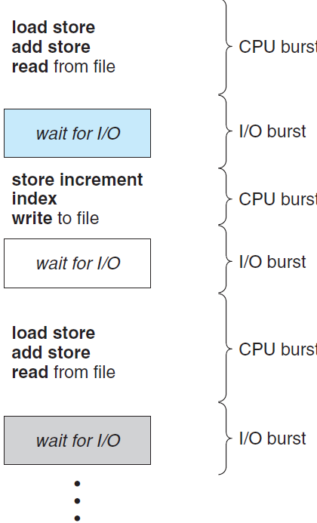

Slide 6
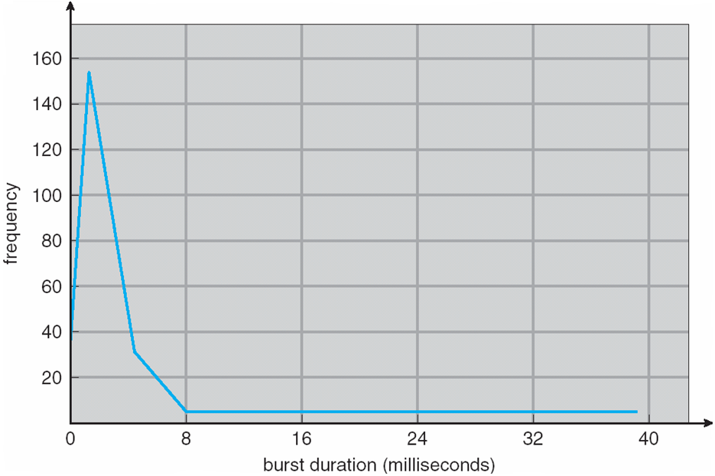
Histogram of CPU-burst Times

Slide 7
CPU Scheduler
Short-term scheduler selects from among the processes in ready queue, and allocates the CPU to one of them
Queue may be ordered in various ways, not necessarily FIFO.
CPU scheduling decisions may take place when a process:
Switches from running to waiting state, for example an invocation of wait()
Switches from running to ready state, for example when an interrupt occurs
Switches from waiting to ready, for example at completion of I/O
Terminates
For situations 1 and 4, there is no choice in terms of scheduling. A new process (if one exists in the ready queue) must be selected for execution.
There is a choice, however, for situations 2 and 3.

Slide 8
Preempitive VS Non-Premeptive Scheduling
Under nonpreemptive scheduling, once the CPU has been allocated to a process, the process keeps the CPU until it releases it either by terminating or by switching to the waiting state
All other scheduling is preemptive
Unfortunately, preemptive scheduling can result in race conditions when data are shared among several processes
Consider access to shared data
Consider preemption while in kernel mode
Consider interrupts occurring during crucial OS activities

Slide 9
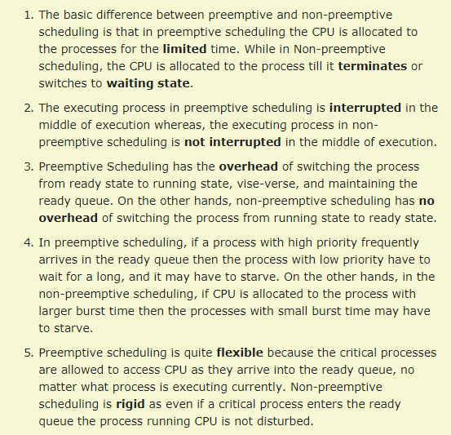

Slide 10
Dispatcher
Another component involved in the CPU-scheduling function
Dispatcher module gives control of the CPU to the process selected by the short-term scheduler; this involves:
switching context
switching to user mode
jumping to the proper location in the user program to restart that program
Dispatch latency – time it takes for the dispatcher to stop one process and start another running

Slide 11
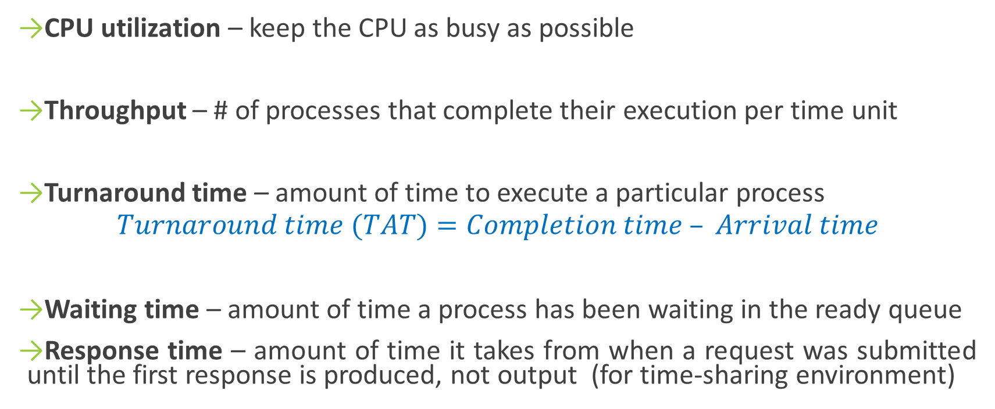
Scheduling Criteria
CPU utilization – keep the CPU as busy as possible
Throughput – # of processes that complete their execution per time unit
Turnaround time – amount of time to execute a particular process
$$Turnaround time (TAT)=Completion time – Arrival time$$
Waiting time – amount of time a process has been waiting in the ready queue
Response time – amount of time it takes from when a request was submitted until the first response is produced, not output (for time-sharing environment)

Slide 12
Scheduling Algorithm Optimization Criteria
Max CPU utilization
Max throughput
Min turnaround time
Min waiting time
Min response time

Slide 13
Scheduling Algorithms: First-Come, First-Served (FCFS) Scheduling
the process that requests the CPU first is allocated the CPU first
Process Burst Time
P₁ 24
P₂ 3
P₃ 3
Suppose that the processes arrive in the order: P₁ , P₂ , P₃
The Gantt Chart for the schedule is:
P₁
P₂
P₃
0
24
27
30

Slide 14

First-Come, First-Served (FCFS) Scheduling
Waiting time for P₁ = 0; P₂ = 24; P₃ = 27
Average waiting time: $(0 + 24 + 27)/3 = 17$

Slide 15

FCFS Scheduling (Cont.)
Suppose that the processes arrive in the order: P₂ , P₃ , P₁
Waiting time for P₁ = 6; P₂ = 0; P₃ = 3
Average waiting time: (6 + 0 + 3)/3 = 3
Thus, the average waiting time under an FCFS policy is generally not minimal and may vary substantially if the processes’ CPU burst times vary greatly.
Convoy effect - short process behind long process
Consider one CPU-bound and many I/O-bound processes

Slide 16
Scheduling Algorithms: Shortest-Job-First (SJF) Scheduling
Associate with each process the length of its next CPU burst
Use these lengths to schedule the process with the shortest time
SJF is optimal – gives minimum average waiting time for a given set of processes
The difficulty is knowing the length of the next CPU request
Could ask the user

Slide 17
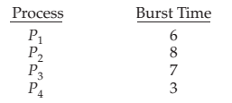

Example of SJF
Average waiting time = (3 + 16 + 9 + 0) / 4 = 7

Slide 18
Although the SJF algorithm is optimal, it cannot be implemented at the level of CPU scheduling, as there is no way to know the length of the next CPU burst.
One approach to this problem is to try to approximate SJF scheduling.
We may not know the length of the next CPU burst, but we may be able to predict its value.
By computing an approximation of the length of the next CPU burst, we can pick the process with the shortest predicted CPU burst.

Slide 19
Preemptive SJF vs Non-preemptive SJF
The SJF algorithm can be either preemptive or nonpreemptive.
The choice arises when a new process arrives at the ready queue while a previous process is still executing.
The next CPU burst of the newly arrived process may be shorter than what is left of the currently executing process.
A preemptive SJF algorithm will preempt the currently executing process, whereas a nonpreemptive SJF algorithm will allow the currently running process to finish its CPU burst.
Preemptive SJF scheduling is sometimes called shortest-remaining time first scheduling

Slide 20
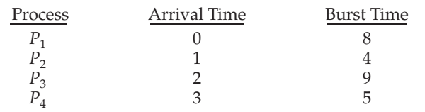
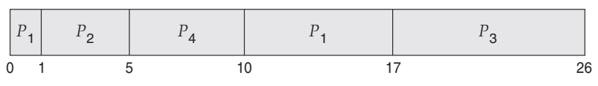
Premptive-SJF-Example
The average waiting time for this example is
$[(10 − 1) + (1 − 1) + (17 − 2) + (5 − 3)]/4 = 26/4 = 6.5$ milliseconds

Slide 21

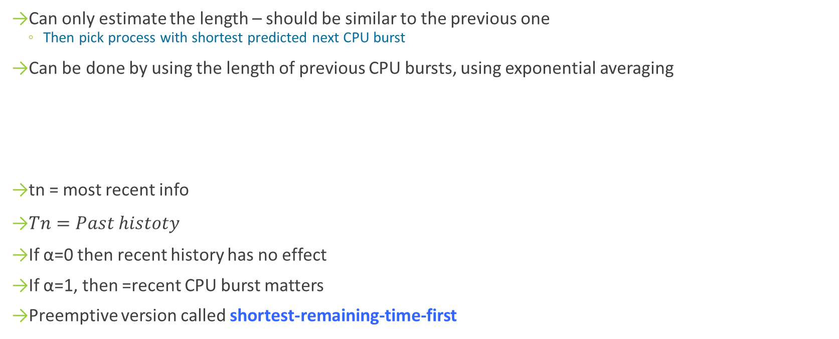
Determining Length of Next CPU Burst
Can only estimate the length – should be similar to the previous one
Then pick process with shortest predicted next CPU burst
Can be done by using the length of previous CPU bursts, using exponential averaging
tn = most recent info
$Tn=Past histoty$
If α=0 then recent history has no effect
If α=1, then =recent CPU burst matters
Preemptive version called shortest-remaining-time-first

Slide 22
Prediction of the Length of the Next CPU Burst
Figure 6.3 shows an exponential average with Alpha= 1/2 and T0 = 10.

Slide 23
Priority Scheduling
A priority number (integer) is associated with each process
The CPU is allocated to the process with the highest priority (smallest integer ≡ highest priority)
Preemptive
Nonpreemptive
SJF is priority scheduling where priority is the inverse of predicted next CPU burst time
Problem ≡ Starvation – low priority processes may never execute
Solution ≡ Aging – as time progresses increase the priority of the process

Slide 24
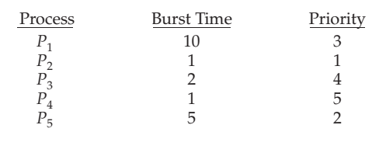
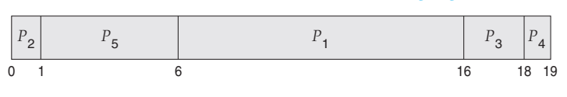
Example of Priority Scheduling
Average waiting time = 8.2 msec

Slide 25
Priority scheduling can be either preemptive or nonpreemptive.
A preemptive priority scheduling algorithm will preempt the CPU if the priority of the newly arrived process is higher than the priority of the currently running process.
A nonpreemptive priority scheduling algorithm will simply put the new process at the head of the ready queue.

Slide 26
Priority scheduling algorithm can leave some low priority processes waiting indefinitely.
In a heavily loaded computer system, a steady stream of higher-priority processes can prevent a low-priority process from ever getting the CPU
A solution to the problem of indefinite blockage of low-priority processes is aging.
Aging involves gradually increasing the priority of processes that wait in the system for a long time

Slide 27
Round Robin (RR)
Each process gets a small unit of CPU time (time slice or time quantum q), usually 10-100 milliseconds. After this time has elapsed, the process is preempted and added to the end of the ready queue.
Timer interrupts every quantum to schedule next process
Performance
q large ⇒ FIFO
q small ⇒ q must be large with respect to context switch, otherwise overhead is too high

Slide 28
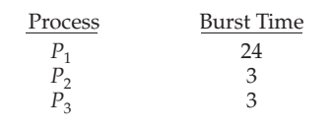
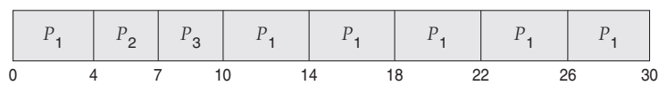
Example of RR with Time Quantum = 4
Completion time = P1=30; P2=7; P3=10
Average waiting time = 5.66 milliseconds
TAT =P1= (30-0); P2=(7-4); P3=(10-7)
Avg. TAT=
Notes:
no process is allocated the CPU for more than 1 time quantum in a row (unless it is the only runnable process). The RR scheduling algorithm is thus preemptive

Slide 29
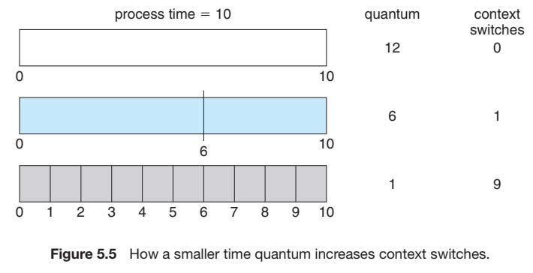

Slide 30
Multilevel Queue Scheduling
In practice, it is often easier to have separate queues for each distinct priority, and priority scheduling simply schedules the process in the highest-priority queue.
This approach—known as multilevel queue—also works well when priority scheduling is combined with round-robin.
If there are multiple processes in the highest-priority queue

Slide 31
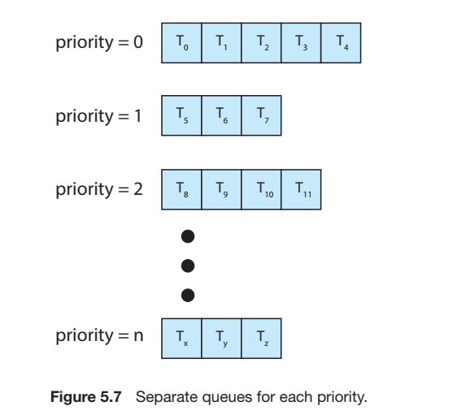

Slide 32
Multilevel Queue Scheduling
A multilevel queue scheduling algorithm can also be used to partition processes into several separate queues based on the process type
Process is assigned to one queue based on memory size, priority, process type.

Slide 33
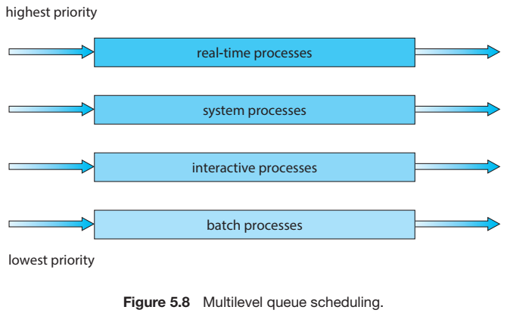

Slide 34
Multilevel Queue Scheduling
Ready queue is partitioned into separate queues, eg:
foreground (interactive)
background (batch)
Each queue has its own scheduling algorithm:
foreground – RR
background – FCFS
Scheduling must be done between the queues:
Fixed priority scheduling; (i.e., serve all from foreground then from background).
Time-slicing among the queues. Here, each queue gets a certain portion of the CPU time, which it can then schedule among its various processes

Slide 35
Multilevel Feedback Queue
The multilevel feedback queue scheduling algorithm, allows a process to move between queues
Idea is to separate process according to CPU burst time
If a process uses too much CPU time, it is moved to low priority
If a process waits too long (aging) in low priority then it is moved to high priority
Multilevel-feedback-queue scheduler defined by the following parameters:
number of queues
scheduling algorithms for each queue
method used to determine when to upgrade a process
method used to determine when to demote a process
method used to determine which queue a process will enter when that process needs service

Slide 36
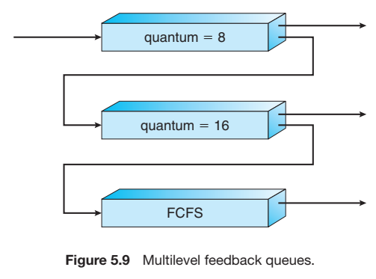

Slide 37
Example of Multilevel Feedback Queue
Three queues:
Q₀ – RR with time quantum 8 milliseconds
Q₁ – RR time quantum 16 milliseconds
Q₂ – FCFS
Scheduling
A new job enters queue Q₀ which is served FCFS
When it gains CPU, job receives 8 milliseconds
If it does not finish in 8 milliseconds, job is moved to queue Q₁
At Q₁ job is again served FCFS and receives 16 additional milliseconds
If it still does not complete, it is preempted and moved to queue Q₂

Slide 38
Multiple-Processor Scheduling
CPU scheduling more complex when multiple CPUs are available
Asymmetric multiprocessing – only one processor accesses the system data structures, alleviating the need for data sharing
Symmetric multiprocessing (SMP) – each processor is self-scheduling, all processes in common ready queue, or each has its own private queue of ready processes
Notes:
we could use some form of locking to protect the common ready queue from this race condition

Slide 39
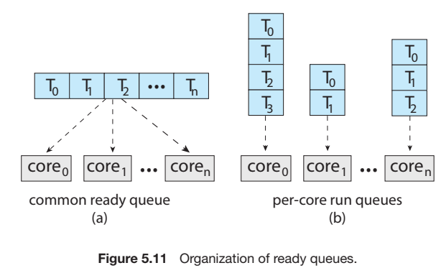

Slide 40
Multiple-Processor Scheduling – Load Balancing
If SMP, need to keep all CPUs loaded for efficiency, Load balancing attempts to keep workload evenly distributed
Push migration – periodic task checks load on each processor, and if found pushes task from overloaded CPU to other CPUs
Pull migration – idle processors pulls waiting task from busy processor
Disadvantages of migration?

Slide 41
Multiple-Processor Scheduling
Processor affinity – process has affinity for processor on which it is currently running
soft affinity: When an operating system has a policy of attempting to keep a process running on the same processor—but not guaranteeing that it will do so known as soft affinity.
hard affinity: allowing a process to specify a subset of processors on which it may run.

Slide 42
Real-Time CPU Scheduling
Soft real-time systems – no guarantee as to when critical real-time process will be scheduled
Hard real-time systems – task must be serviced by its deadline
Two types of latencies affect performance
Interrupt latency – time from arrival of interrupt to start of routine that services interrupt
Dispatch latency – time for schedule to take current process off CPU and switch to another

Slide 43
